Slide 1
OVARIAN TUMORS
DR RUBAIYA, Tutor, Department of Pathology
S.K.Medical College, Muz

Slide 2
Ovarian tumors
80% are benign occuring mostly in young women between the ages of 20 and 45 years
Borderline tumors occur at slightly older ages
Malignant tumors are more common in older women, between the ages of 45 and 65 years

Slide 3
3% of all cancers in females
5th most common cancer leading to death in women
Risk Factors :
Nulliparity
Genetic factors (BRCA1, BRCA2 and p53 mutations, over expression of Her 2neu gene)
Gonadal dysgenesis
Decreased incidence in persons who have taken OC and tubal ligation

Slide 4
Symptoms : abdominal pain, abdominal enlargement (ascites), pressure on neighbouring organs, vaginal bleeding, U/S
First clinical presentation may be ascites
Malignant ascites in a woman is ovarian cancer until proven otherwise
Spread: peritoneum, contralateral ovary, liver, lung, GI tract

Slide 5
Ovarian tumors
Classification ( by origin)
Surface epithelial stromal tumor
Germ cells tumors
Sex cords – stroma tumors
Metastatic tumors

Slide 6
Surface epithelial tumors
Most common accounting for approximately 2/3rd of ovarian tumors
CA-125 is THE important tumor marker
Classified on the basis of differentiation and extent of proliferation of the surface epithelium into any mullerian type epithelium

Slide 7
The major histologic types based on the differentiation of the neoplastic epithelium:
-serous
-mucinous
-endometrioid tumors
-clear cell tumor
-transitional tumor

Slide 8
Based on extent of epithelial proliferation ,they are classified as
-benign
-borderline
-malignant.

Slide 9
The benign tumors are often further subclassified on the basis of components of the tumors as-
-cystadenomas- prominantly cystic component
-cystadenofibromas- cystic and fibrous areas
-adenofibromas- predominantly fibrous areas

Slide 10
1. Serous tumors
60% benign
15% borderline
25% malignant

Slide 11
Serous cysadenoma
Typically a unilocular cyst with no epithelial thickening
Cyst wall is smooth and glistening
Microscopically, the cysts are lined by columnar epithelium, which has abundant cilia
Small papillary projections may be seen

Slide 12
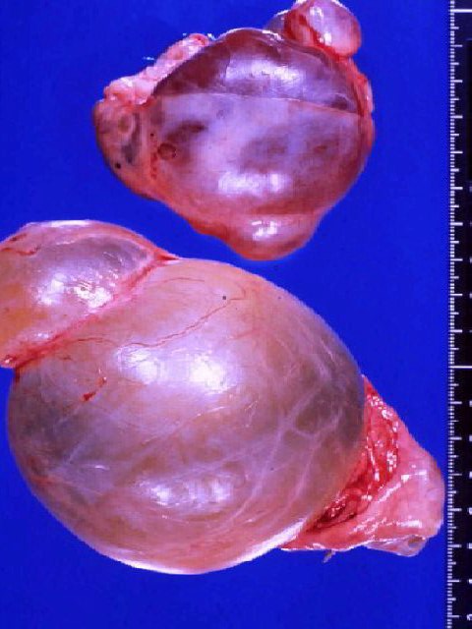
SEROUS, BENIGN

Slide 13
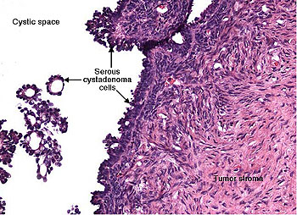

Slide 14
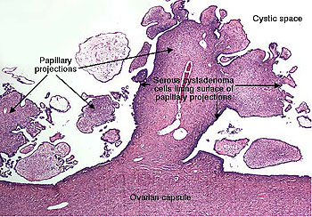

Slide 15
Boarderline serous tumors
low malignant potential tumors
typically a unilocular cyst with some solid areas and papillary excresences
epithelial lining is more complex with cell stratification , tufting and mild to moderate cellular atypia
Stromal invasion not seen
a small percentage may recur after surgical excision

Slide 16
Serous ovarian carcinoma
Serous ovarian carcinoma is divided into two major groups:
(1) low-grade (well-differentiated) carcinoma
(2) high-grade (moderately to poorly differentiated) carcinoma.
This distinction is based on the degree of nuclear atypia

Slide 17
Mutational profile
Low-grade tumors arising in serous borderline tumors have mutations in the KRAS, BRAF, or ERBB2 oncogenes, and usually have wild type TP53 genes.

Slide 18
High-grade tumors have a high frequency of TP53 mutations
Almost all ovarian carcinomas arising in women with BRCA1 or BRCA2 mutations are high-grade serous carcinomas with TP53 mutations

Slide 19
Genomic imbalances are very common and include amplifications of a number of oncogenes (e.g., PIK3CA) and deletions of tumor suppressor genes (e.g., RB)

Slide 20
Grossly tumors are large friable with multiloculated cysts and polypoidal growths
Most commonly present as bilateral masses with widespread peritoneal metastases

Slide 21
Microscopically the tumors show a wide variety of architectural patterns like solid, papillary or nested with slit like spaces with marked nuclear atypia
Destructive stromal invasion is seen
Concentric calcifications (psammoma bodies) characterize serous tumors, but are not specific for neoplasia

Slide 22
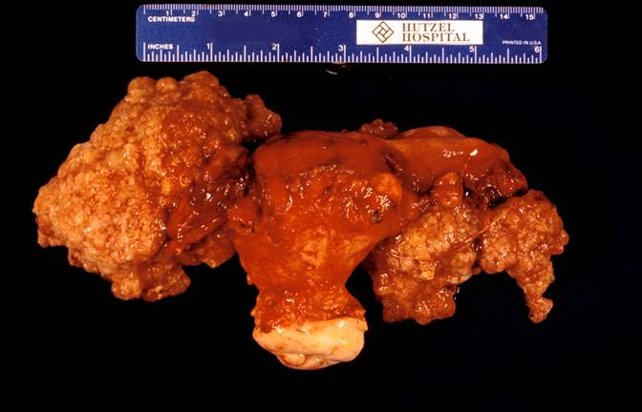
Ovarian Carcinoma

Slide 23
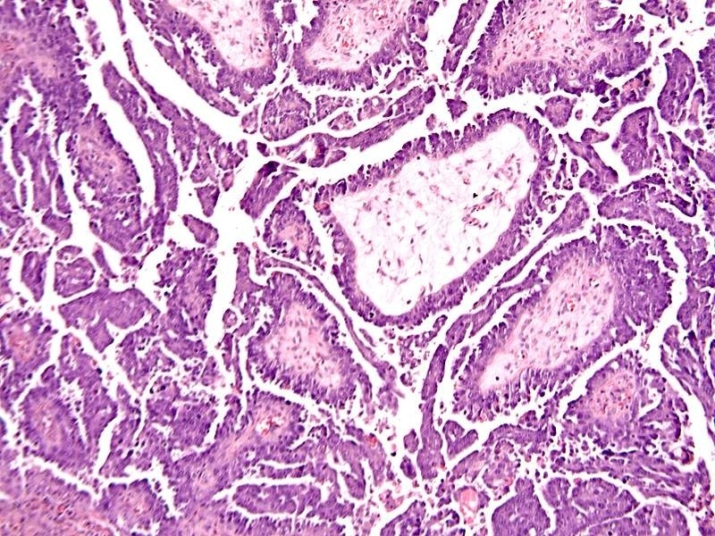
Notes:
Close up of papillae

Slide 24
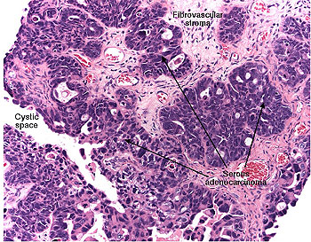

Slide 25
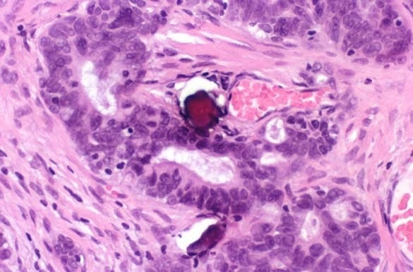
Psammoma bodies
Notes:
PSAMMOMA bodies

Slide 26
2. Mucinous Tumors
less common
middle-aged women
80% benign
10% borderline
10% malignant
Notes:
MA: multilocular, large, cystic masses filled with viscous, gelatinous material

Slide 27
Pathogenesis
Mutation of the KRAS proto-oncogene is a consistent genetic alteration in mucinous tumors of the ovary, including the benign mucinous cystadenomas (58%), mucinous borderline tumors (75% to 86%), and ovarian mucinous carcinomas (85%)

Slide 28
Mucinous Tumors
Mucinous tumors tend to produce larger cystic masses
They are multiloculated tumors filled with sticky, gelatinous fluid rich in glycoproteins
Cysts lined by tall columnar mucin producing epithelial cells

Slide 29
Microscopically, benign mucinous tumors are characterized by a lining of tall, columnar epithelial cells with apical mucin that lack cilia
Vast majority show intestinal type differentiation with few showing endocervical type

Slide 30
in borderline tumors: complex glandular or papillary architecture, nuclear crowding and atypia with mitoses
in malignant tumors: above criteria but more pronounced and stromal invasion and necrosis

Slide 31
Pseudomyxoma peritonei- a clinical condition marked by extensive mucinous ascitis, Epithelial implants on the peritoneum→adhesions due to mucin-
If extensive, intestinal obstruction and death

Slide 32
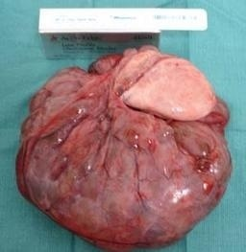
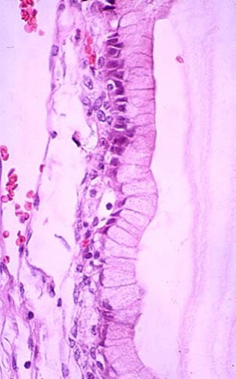
MUCINOUS, BENIGN
Notes:
The HUGEST tumors ever reported in human beings (50-100 lbs.?) are frequently benign mucinous ovarian tumors.

Slide 33
borderline mucinous tumor

Slide 34
Mucinous tumor- borderline

Slide 35
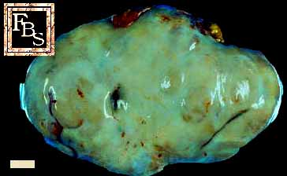

Slide 36
Mucinous cystadenocarcinoma

Slide 37
3. Endometrioid Tumors
Mostly malignant (carcinoma)
15-30% of the cases with synchronous endometrioid adenocarcinoma
May coexist with endometriosis
Molecular changes are similar to endometrial endometroid carcinoma

Slide 38
MA: -size ranges from 2 to 30 cm
-majority are solid with necrotic areas
-some may show solid and cystic areas both
-may be bilateral
MI: glandular structures resembling endometrial glands

Slide 39
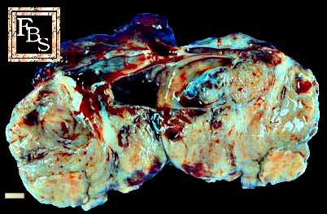

Slide 41
4. Clear cell tumors
Benign and borderline tumors are rare
MA: cystic mass
MI: large hobnail cells with clear cytoplasm and high nuclear grade
Occur in association with endometriosis and endometrioid carcinoma

Slide 43
5. Brenner Tumor
Mostly benign and relatively uncommon
MA: Predominantly solid and rarely cystic, vary in size- upto 20 to 30 cm
90% unilateral
MI: nests of bland transitional epithelial cells within a fibrous stroma
occasionally occuring with mucinous cystadenomas

Slide 45
Sex Cord-Stromal Tumors
Granulosa cell tumors
Fibromas
Fibrothecomas
Thecomas
Sertoli-Leydig cell tumors
Steroid (lipid) cell tumors

Slide 46
Granulosa cell tumor
At any age, typically post-menopausal patients
Accounts for 5 % of all ovarian neoplasms
Feminizing tumors as it produce estrogen
Potentially malignant- The likelihood of malignant behavior (recurrence, extension) ranges from 5% to 25%

Slide 47
Adult granulosa cell tumor(95%)
Macroscopically
-usually unilateral, vary from microscopic foci to large solid solid and cystic areas
-hormonally active tumors show yellow coloration due to intracellular lipids

Slide 48
Microscopically
-Small, cuboidal to polygonal cells growing in anastomosing cords, sheets, or strands
-tumor cells show “coffee-bean” like nuclei,
-some cases show microfollicular structure filled with acidophilic material (Call- Exner bodies)

Slide 49
Juvenile granulosa cell tumor
Accounts for about 5% of all granulosa cell tumors
Mean age is 13 yrs
Most prepubertal patients present with sexual precocity due to excessive estrogen production

Slide 50
Gross description
Usually unilateral, up to 12 cm
Multiloculated, cystic and solid tumor with yellow-white solid areas
May have hemorrhage and necrosis

Slide 51
Microscopically
Diffuse or macrofollicular patterns with microcysts containing eosinophilic secretions
Tumor cells have scant cytoplasm, round / oval hyperchromatic nuclei with small nucleoli, irregular nuclear contours, rare nuclear grooves and high mitotic rate

Slide 52
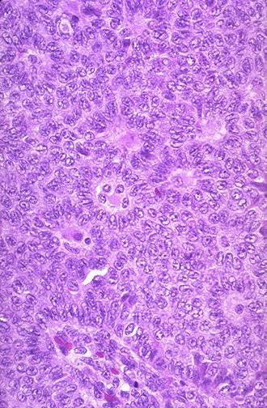
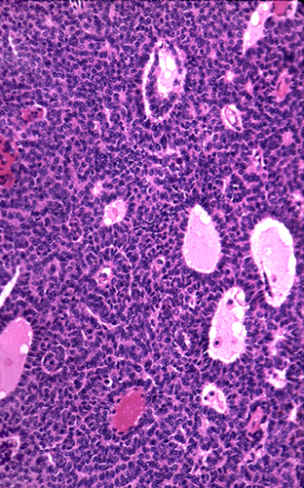
Granulosa cell tumor

Slide 53
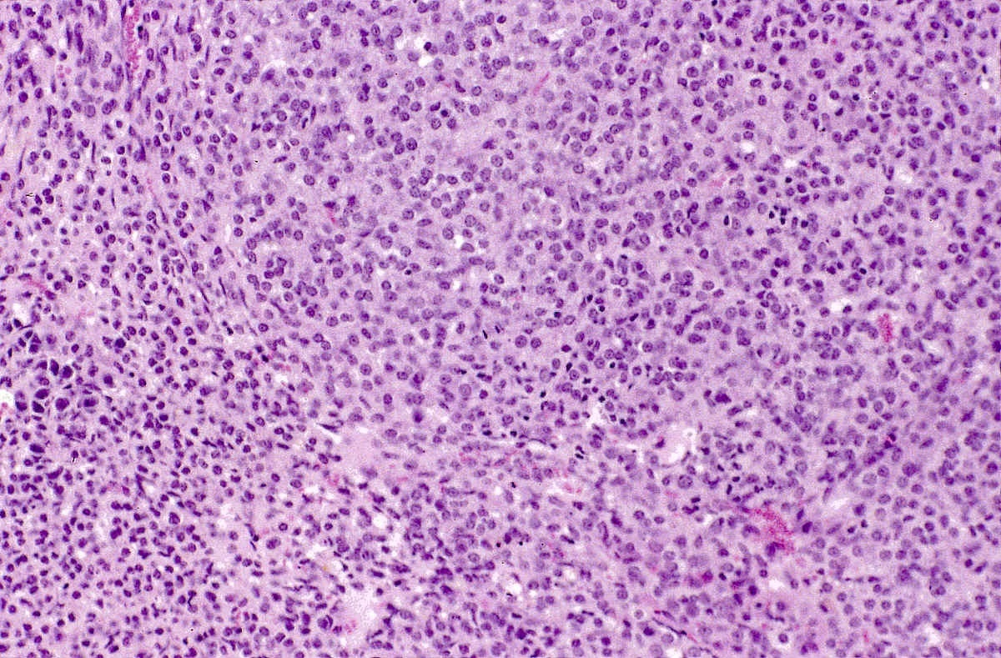
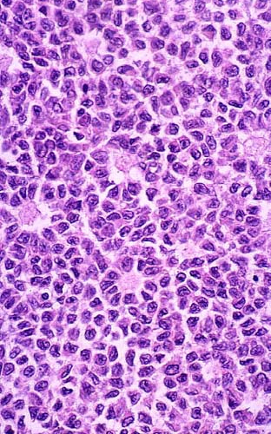
CALL-EXNER
BODIES
Notes:
Call-Exner bodies are virtually diagnostic of granulosa cell tumors.
Q: Do they remind you of “rosettes”? Ans: YES

Slide 54
Fibroma, Thecoma and Fibrothecomas
They are unilateral in about 90% of cases
usually solid, spherical or slightly lobulated, encapsulated, hard, gray-white masses
covered by glistening, intact ovarian serosa

Slide 55
Fibroma: composed of fibroblasts and hormonally inactive
Thecoma: plump spindle cells with lipid droplets. Rare but hormonally active
Fibrothecomas: admixture of the two.

Slide 56
Clinically present as a pelvic mass accompanied by pain and two decidedly curious associations.
The first is ascites and uncommonly there is also a hydrothorax, usually only on the right side.
This combination of findings (ovarian tumor, hydrothorax, and ascites) is designated Meigs syndrome

Slide 57
The second association is with the basal cell nevus syndrome charecterized by
Development of more than 2 basal cell carcinomas before the age of 20
Cysts in jaw & Calcification of the falx cerebri
Pits in the palms and soles of the feet
Macrocephaly (enlarged head size)
Rib or vertebral abnormalities

Slide 60
Sertoli-Leydig cell tumors
Uncommon, all age groups, peak 2nd to 3rd decade
Masculinization
Recapitulating the structure of the testis at various stages of development
Gross : unilateral, solid, grey to golden brown
Micro: tubules with sertoli cells with Leydig cells in the stroma

Slide 61
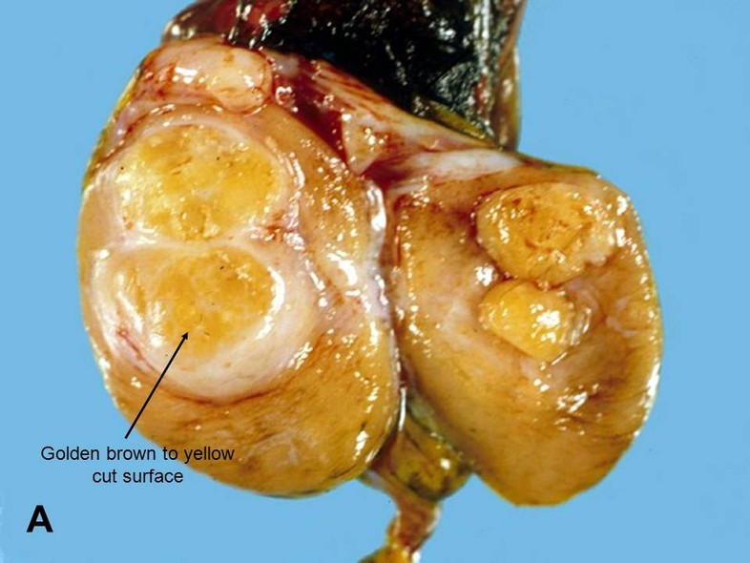

Slide 63
Others
Lipid cell tumor-
-Rare tumor
-Up to 45 cm, solid, well-circumscribed, yellow- orange to red-brown.
-Sometimes bilateral
-Associated with androgenic changes in 56-77%

Slide 64
Hilus cell tumors (pure Leydig cell tumors)
-These rare, unilateral and comprised of large lipid-laden Leydig cells with distinct borders and characteristic cytoplasmic structures called Reinke crystalloids.
-Women with hilus cell tumors usually present with evidence of masculinization as the tumor produce predominantly testosterone

Slide 65
Gynandroblastoma
Mixture of granulosa theca cells and Sertoli- leydig cells
Gonadoblastoma
Combination of germ cells and sex-cord stromal cells
In sexually abnormal individuals

Slide 66
To be continued….

